Slide 1

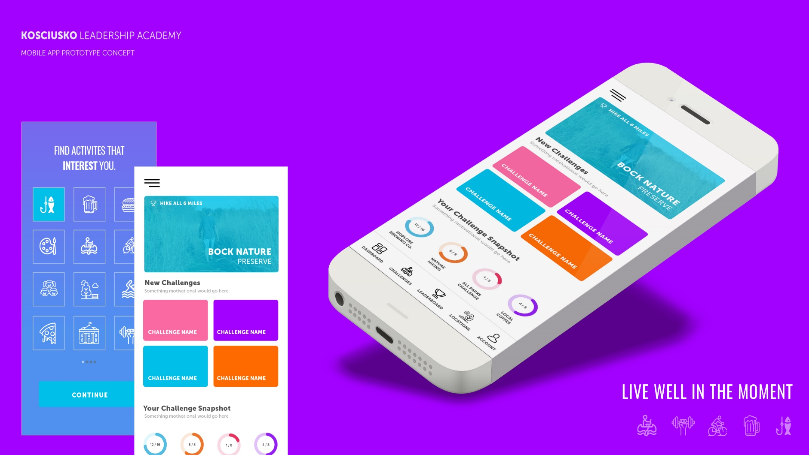
Jill Boggs, Kosciusko Co Convention and Visitors Bureau
Josh Crabb, Creighton Brothers LLC
Greg Sebastian, Medtronic
Tony Wilson, Medtronic
Zach Vigar, Instrumental Machine and Development
ENGAGE KOSCIUSKO
Live Well in the Moment

Slide 2
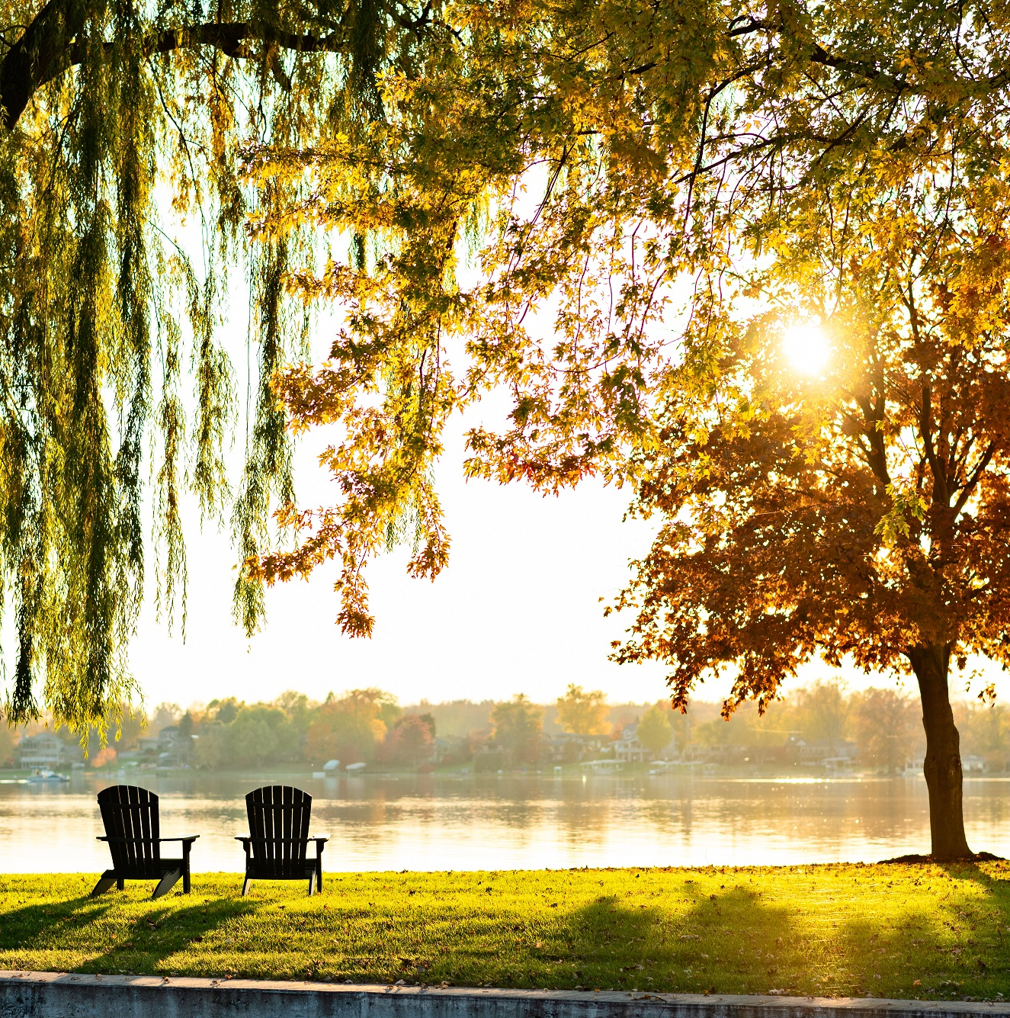
Product – Service – Methodology –
Identifying the Problem to Find the Product
There are plenty of things to see and do in the county that are available for residents and visitors alike, but what if we had a new, dynamic tool to engage.
Group’s Passion for a Solution
Long-term residents and transplants both had new experiences.
Could not believe number of community resources unaware of based on what was learned about in KLA tours.
What else was out there? What tool could we develop?
Passionate about building a new platform to engage people in our place and its amazing assets in a fun, easily accessible, and informed way.
The excitement between the members was contagious.
Methods for Data and Information Collection
These items were used to complete analysis:
Benchmarking of other apps to identify best practices.
Research apps that might be available to help solve the problem.
Functional Requirement Specification created based on benchmarking.
Collected information from app development company for high-level functioning along with extensive cost plan.

Slide 3
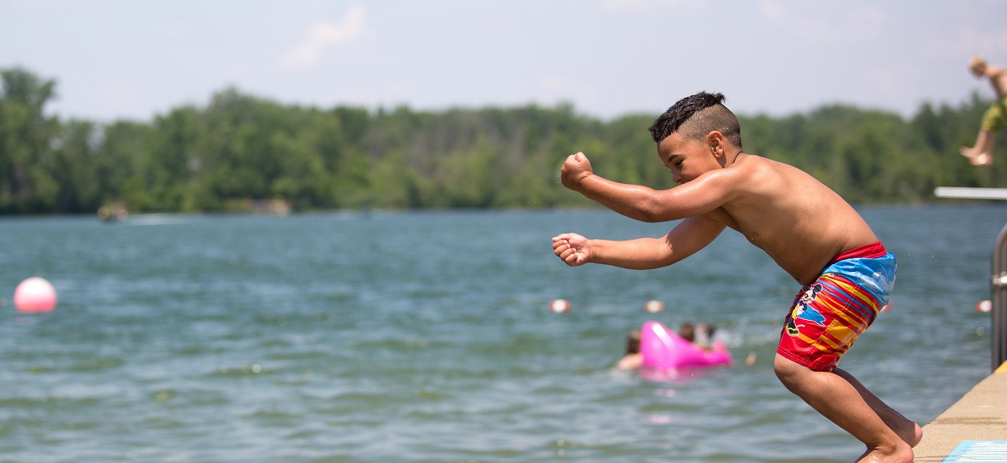
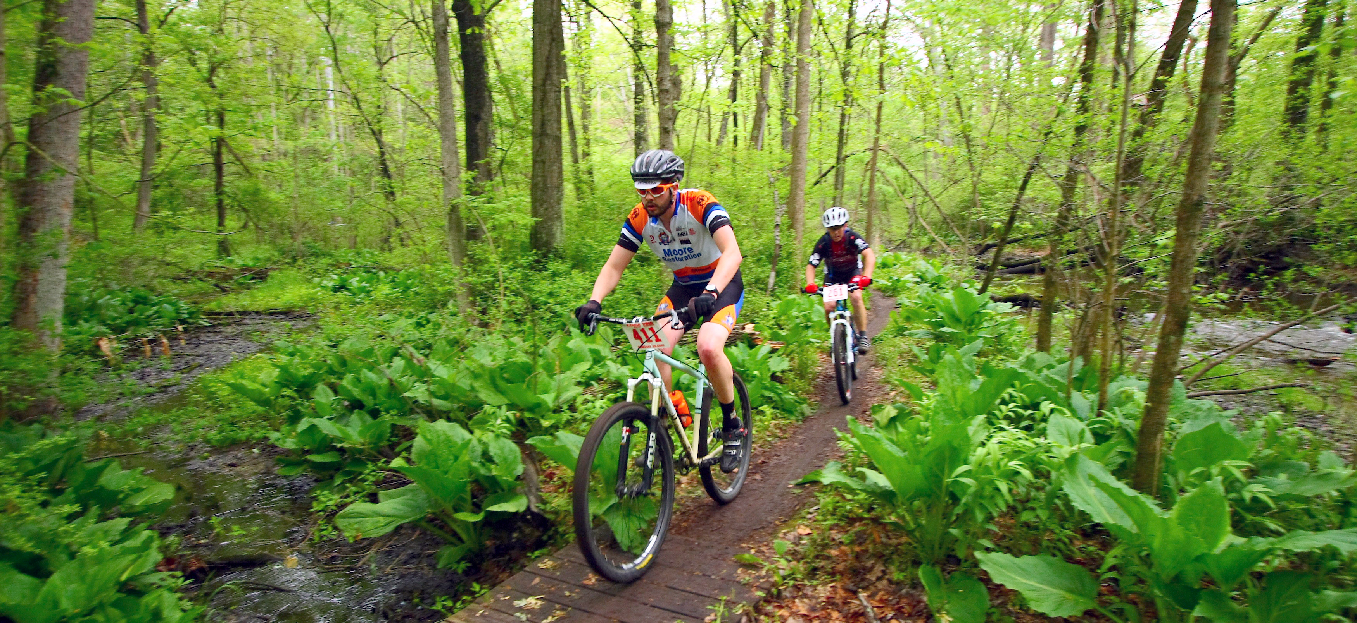
Benchmarking
Research
To find what type of application would best suit the needs of the community.
Review
Studied a wide variety of applications including tourist apps and competition apps.
Analysis
Overall ratings of apps were analyzed and categorically separated.
Captured
Number of downloads – ratings – reviews
Over 50 applications included in process

Slide 4

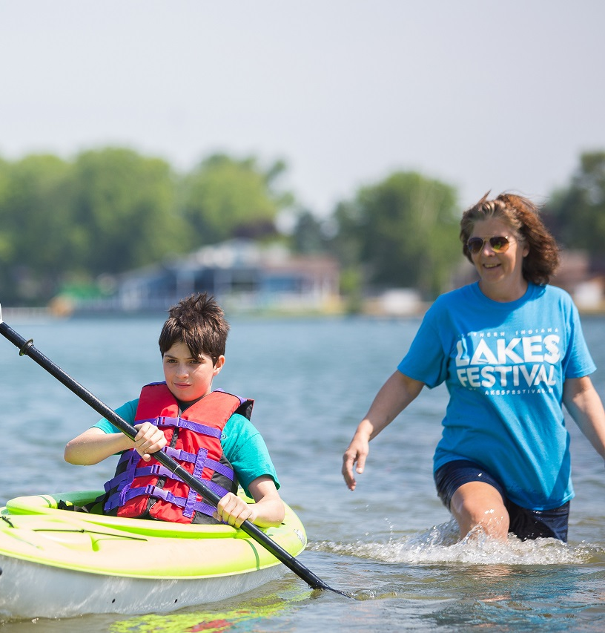
Benchmarking Results
Wish List Discovered after Benchmarking
Offline availability
Interactive Map Feature
Up-to-Date Content
High-Level User Interaction
Leaderboards
Challenge Forums
User Inputs
Suggestions for Challenges
Easy to Navigate
Intuitive Interface
Visual Appeal
Link to Social Media
Link to other Competitive apps
Ability to Build Your Trip/Challenge

Slide 5

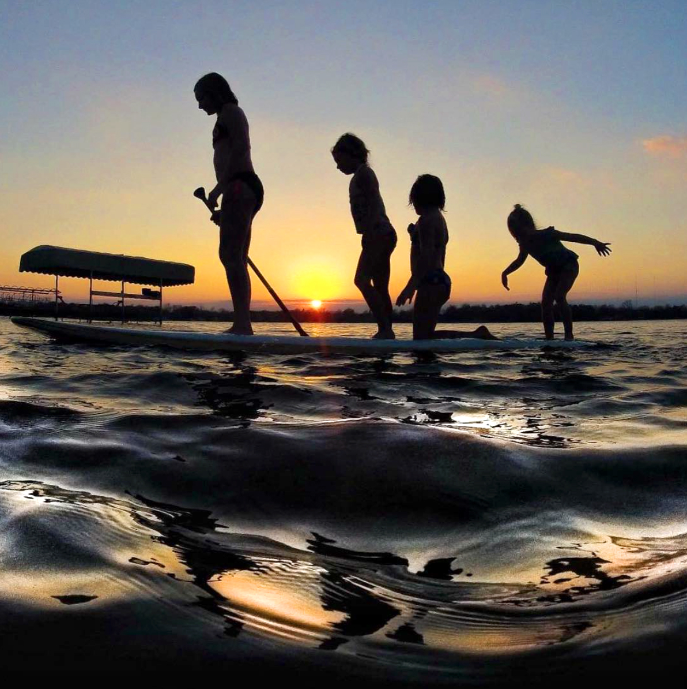
App Feasibility
Local Business Participation
Interest?
Functionality?
Usability?
Developer Selection
Find developer for vision check and feasibility discovery process.
Selected Reusser Design – Digital Firm
KCCVB vetted 23 companies for website development; Reusser award winning.
Developer Initial Meeting
Discussed vision, ideas, research to date, plan
Feedback: “This vision is something special”

Slide 6
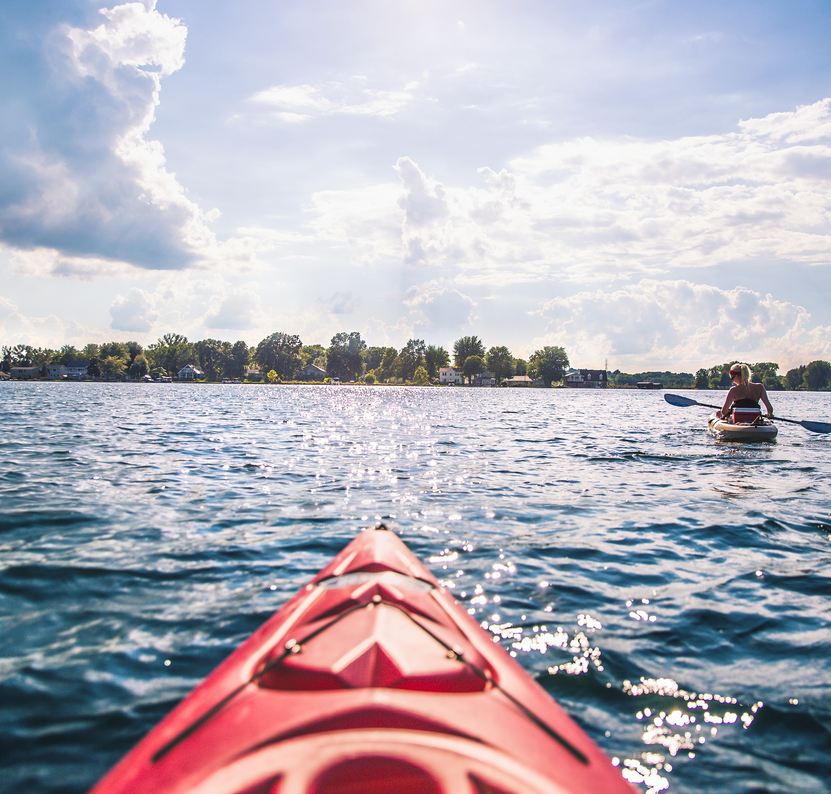
Application
Development
High Level Functionality Review
Reusser Design converted high level functionality concepts into Detail Challenge View.
Custom Native iOS (Apple) and Android mobile app will be developed for Apple and Google Play stores.
User Registration will be required after download.
App will take user to onboarding screen that showcases features and functionality within the app once registered.
Dashboard showing the latest challenges and active challenges will be included on home page.
Users can browse and search for challenges by type of challenge, duration and time frame.
Leaderboards available to see who has the most points in the county or within a specific challenge.

Slide 7
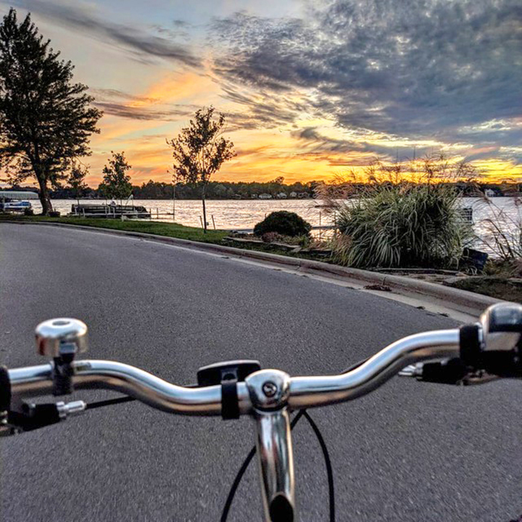
Development Plan
Project Kickoff
Discovery & Technical Planning
Finalize functionality and create detailed functionality requirements.
Content Strategy
Determine the tone/voice and style of writing for messages throughout the app and web application.
User Experience
We will design low-fidelity and high-fidelity prototypes based on functionality.
Development
We will first architect the database model and web application.
Develop iOS app and release for testing then develop Android version.
Develop out the complete functionality of the web application.
Quality Assurance Testing
Test the application
Facilitate feedback and bug testing to ensure the app and application work well before launching.
Application
Development
(Cont’d)

Slide 8
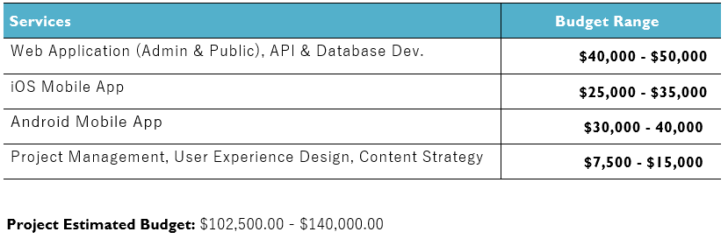
Proposed Budget

Slide 9
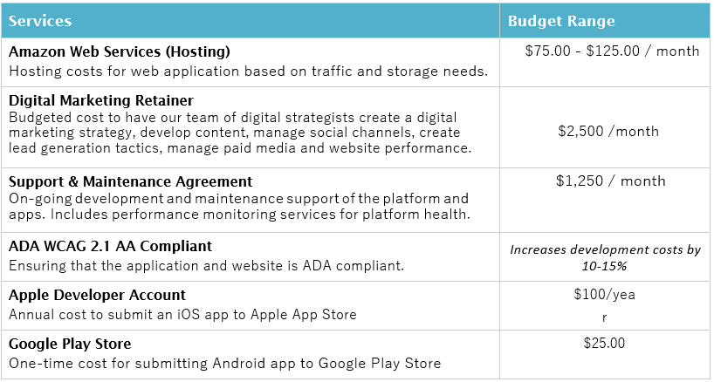
Other Costs to Consider

Slide 10
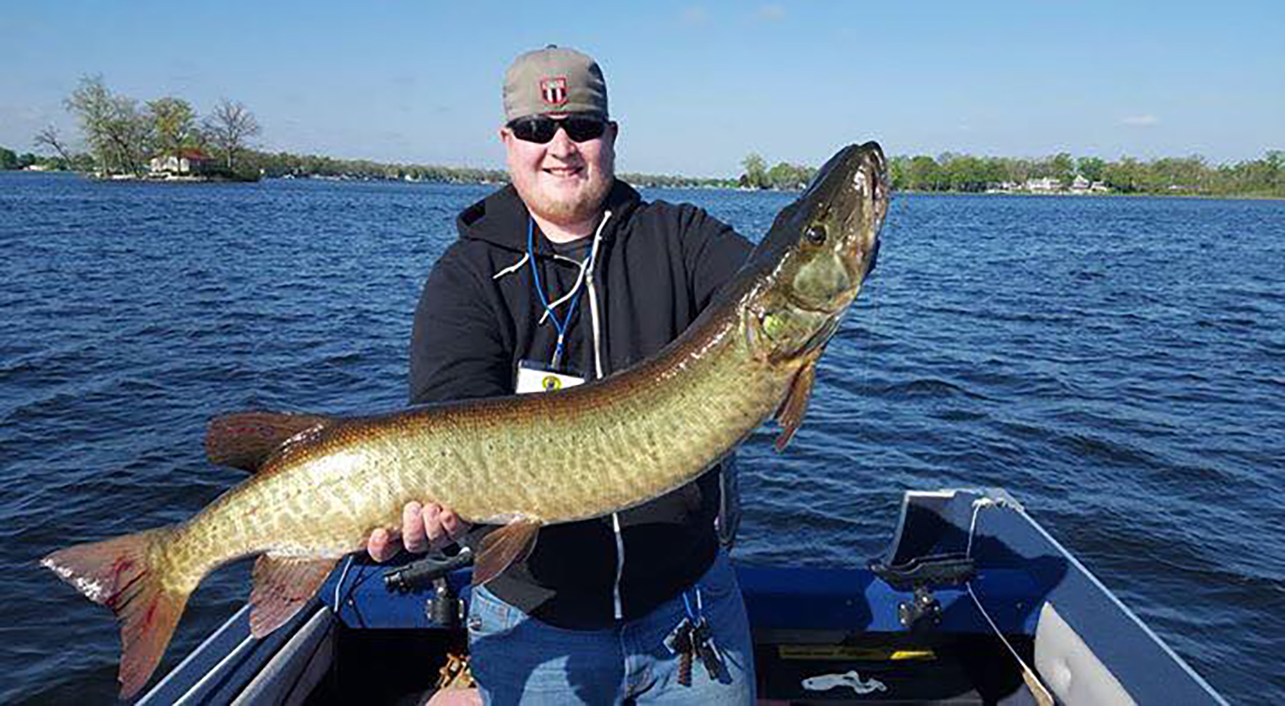
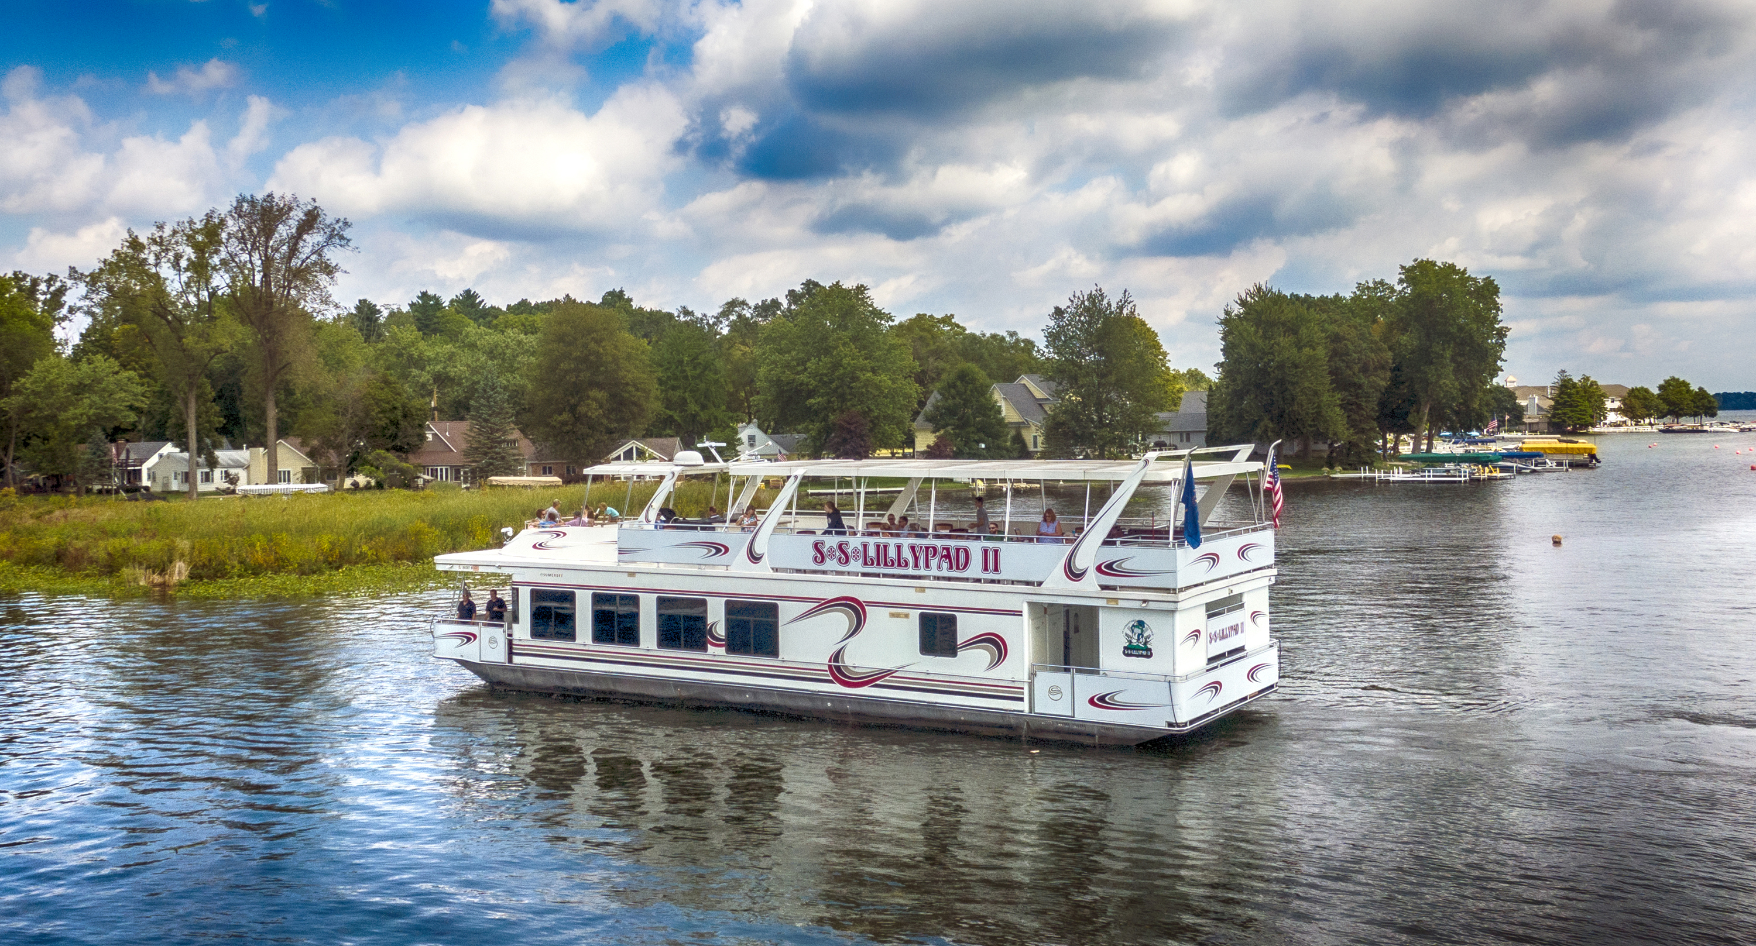
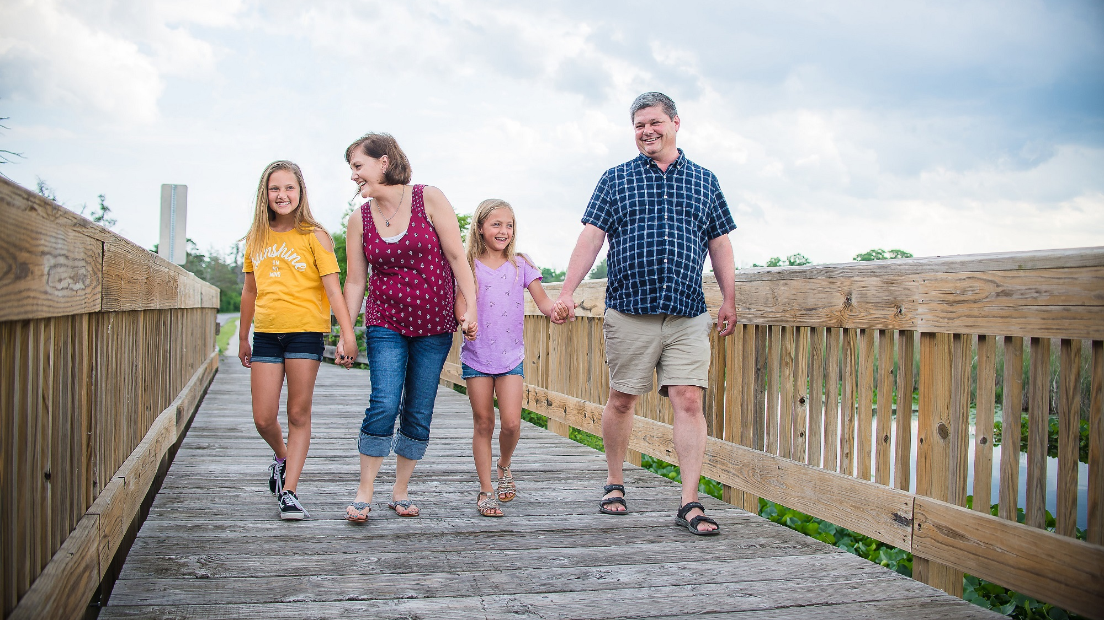
Key Takeaways
County-wide Impact
The Engage Kosciusko application meets a need within the county.
Full plan is already drafted!
Geo Area
All geographical areas of the county where assets exist to develop creative engagement opportunities.
Audiences
Residents
Leisure Visitors
Groups
Visiting Friends and Family
Business Leisure
Corporate Talent Attraction
Sustainability and Scope
KCCVB has agreed to own the app with community interest noted.
Revenue Generation
Do-able
While COVID-19 may have delayed resource gathering to build and launch, confident it is in foreseeable future.
Keys to Successful Engagement
Development
Functionality
Content
Opportunities for New Explorations
Competitions
Marketability
Users w/ ability to Share
Fun!
Live Well in the Moment

Slide 11
SEE YOU IN THE APP!

